Slide 1
Creating high utility synthetic data (with synthpop)

Slide 2
Preserving relationships between variables
Preserving solely univariate distributions is not always sufficient
Statistics Netherlands has awesome data that you can use to answer many research questions
But… these data are often not (easily) accessible
Synthetic data can provide a solution, but only if relationships between variables are preserved

Slide 3
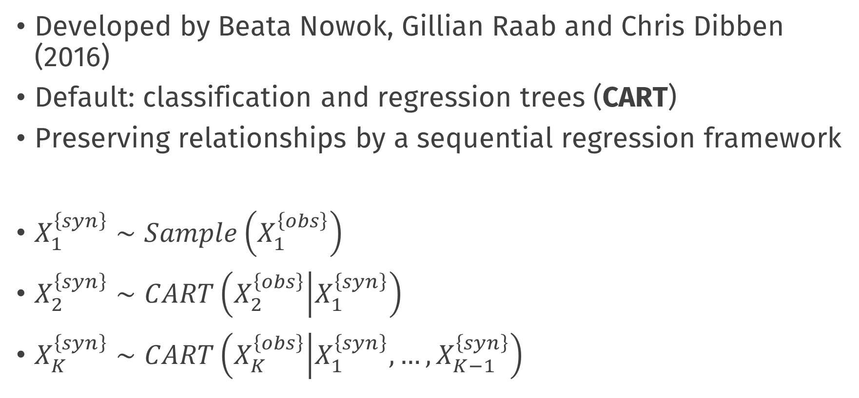
Synthpop
Developed by Beata Nowok, Gillian Raab and Chris Dibben (2016)
Default: classification and regression trees (CART)
Preserving relationships by a sequential regression framework
$X_{1}^{\left\{syn\right\}}∼Sample\left(X_{1}^{\left\{obs\right\}}\right)$
$X_{2}^{\left\{syn\right\}}∼CART\left(X_{2}^{\left\{obs\right\}} | X_{1}^{\left\{syn\right\}}\right)$
$X_{K}^{\left\{syn\right\}}∼CART\left(X_{K}^{\left\{obs\right\}} | X_{1}^{\left\{syn\right\}}, …, X_{K−1}^{\left\{syn\right\}}\right)$

Slide 4
Privacy
Higher privacy risk: CART reuses observed values
How to quantify this remains an open question

Slide 5
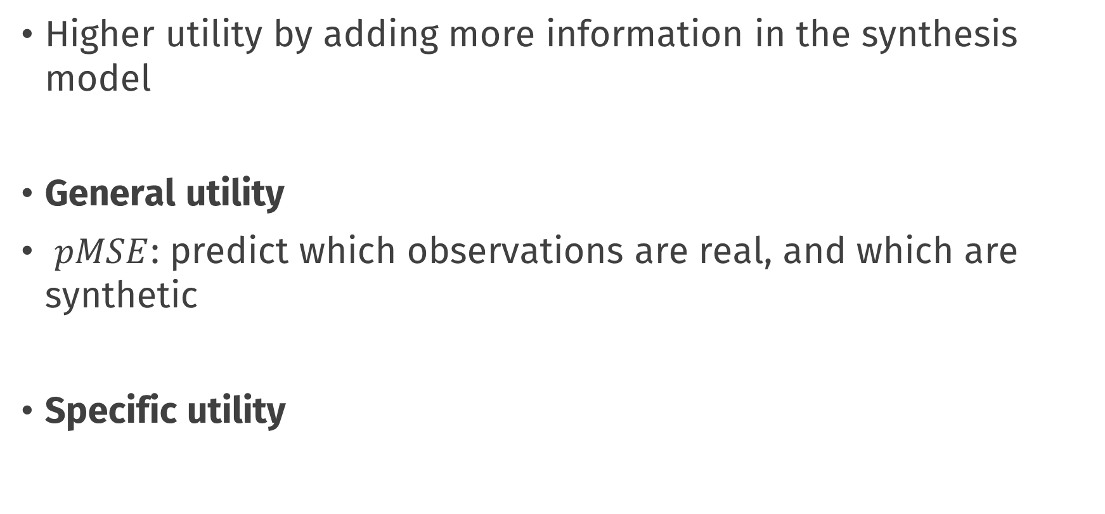
Utility
Higher utility by adding more information in the synthesis model
General utility
$pMSE$: predict which observations are real, and which are synthetic
Specific utility

Slide 6
Enough talking, start doing
Hands-on session: https://thomvolker.github.io/osf_synthetic/osf_synthetic_workshop.html
R Studio or R Studio Cloud
Own data or Heart failure clinical records data (uploading your own data to R Studio Cloud might not be the best idea)
Any questions?

